Slide 2
About Today…
Templating Engine
EJS

Slide 3
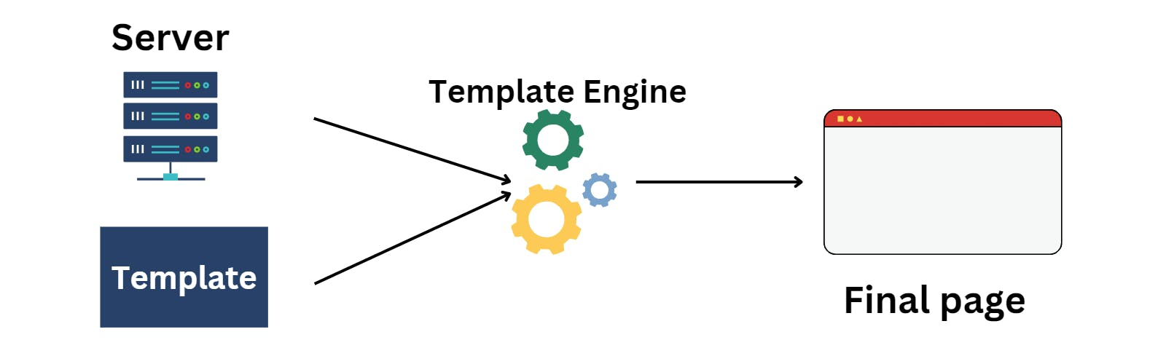

Slide 4
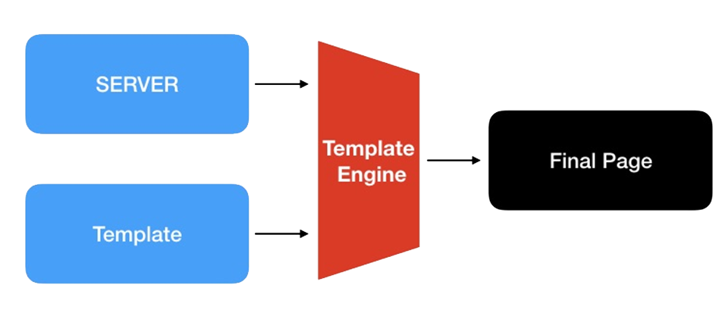
Intro to Templating Engine
Definition
A tool that facilitates the creation of reusable HTML structures by combining
data with templates
Importance
Separate the presentation layer (HTML markup) from the application logic
(server-side code), promoting cleaner code architecture and easier maintenance

Slide 5

Intro to EJS
(Embedded JavaScript)
Definition
A popular templating engine for JavaScript
Allows developers to embed JavaScript code directly within HTML templates
Why is EJS Used?
Simplifies the process of dynamically generating HTML content
Based on data fetched from a server or passed from the application
Enhances flexibility and promotes code reusability

Slide 6


Basic Structure of EJS
Syntax Overview
EJS uses special tags to embed JavaScript code within HTML
<% %>
Executes JavaScript code without outputting to the template
<%= %>
Outputs the result of the JavaScript expression and escapes
HTML characters
<%- %>
Outputs the unescaped value into the template, useful for
HTML content
Example

Slide 7



Installing and Integrating EJS
Installation
EJS can be installed via npm
Integration with Express.js
To use EJS as the default templating engine in Express.js, add the following line in your application setup
This configures Express.js to look for EJS files (ending in .ejs) in the views/ directory

Slide 8


Rendering Views with EJS
Using res.render()
An Express.js method used to render an EJS template and send it
as the HTTP response
Example
'index' refers to index.ejs in the views/ directory
{ username: 'Guest' } provides data to dynamically populate the template

Slide 9

Key Features of EJS
Supports both server-side and client-side rendering, offering flexibility depending on project needs
Allows for the use of partials and includes, facilitating modular templating and code reuse
Integrates seamlessly with Express.js and other Node.js frameworks, enhancing productivity and scalability

Slide 10

What is a templating engine?
tool that facilitates the creation of reusable HTML structures
Why are templating engines important in web development?
promote cleaner code architecture and easier maintenance
What does EJS stand for?
Embedded JavaScript
What is the purpose of the <%= %> tag in EJS?
outputs the result of the JavaScript expression and escapes HTML characters
What method is used in Express.js to render an EJS template and send it as the HTTP response?
The res.render() method

Slide 11

Task
Create a simple blog application using Express.js and EJS to render dynamic content

